Slide 1
How to drive a car with neural networks

Slide 2
Background
Learn about neural networks through a use case rather than a course
Write the code from scratch (no libraries)
Interface between biology and programming
Notes:
Back over xmas, wanted to learn some about NN/ML
Through a use-case/project instead of just doing a udemy course
Writing code from scratch (no libraries)
Neural networks draw on interface between biology and programming
TRAIN, don’t PROGRAM – feels like it’s alive

Slide 3
What is a neural network?
Inspired by biology
Made of neurons
Numerical inputs/outputs
Notes:
Mimics structures of human/animal brains

Slide 4
Neuron/ Perceptron
X1
W1
∑
Activation function
Output
X2
W2
bias

Slide 5
Training a Neural Network
Supervised
Back propagation
Unsupervised
Adversarial neural networks
Reinforcement
Q-learning
(Genetic algorithms)

Slide 6
Genetic Algorithms
Spawn a number of agents
Measure each agent’s “fitness”
Breed the fittest agents
Mutate some of the offspring
Repeat

Slide 7
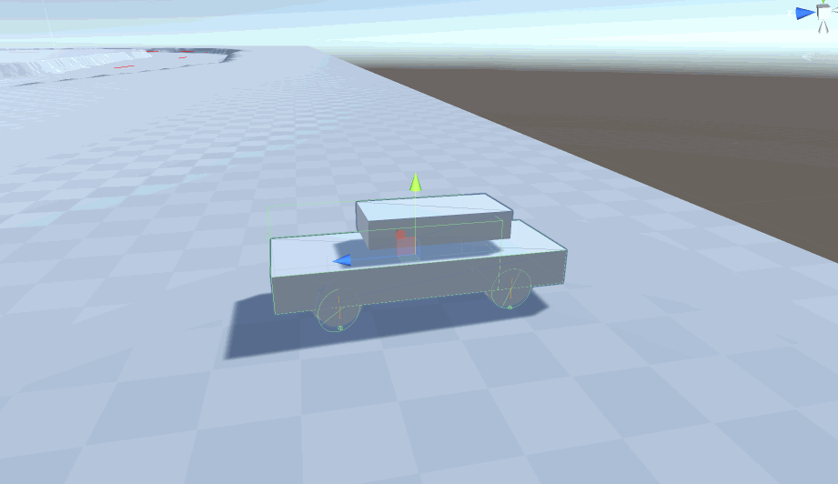
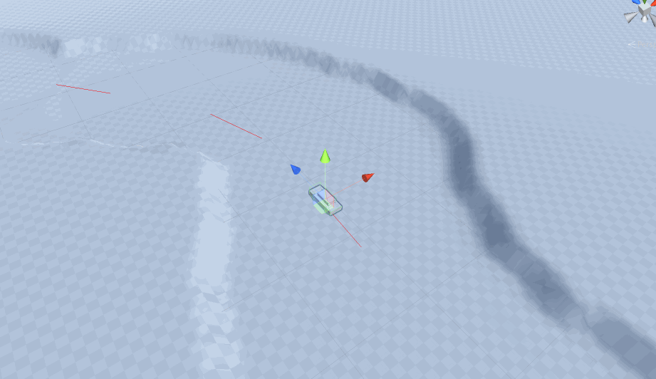
The challenge
Race a car around a track
Using REAL PHYSICS!
Car has 3 inputs:
Acceleration (-1 to +1)
Steering (-1 to +1)
Braking (0 to +1)
Notes:
Real Physics
Momentum, wheel colliders which model grip
more realistic/organic
lends itself to NN rather than more traditional AI approaches
Me driving the car in examples

Slide 8
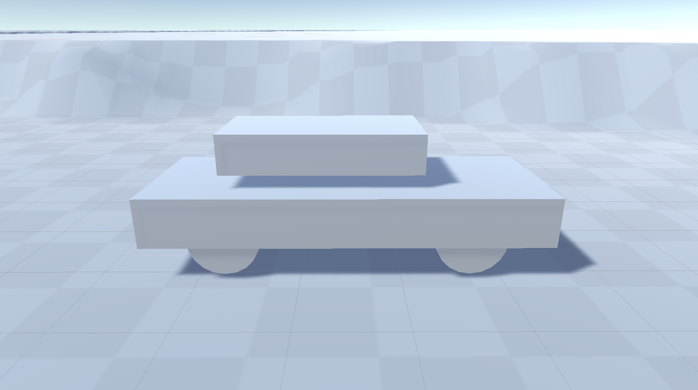
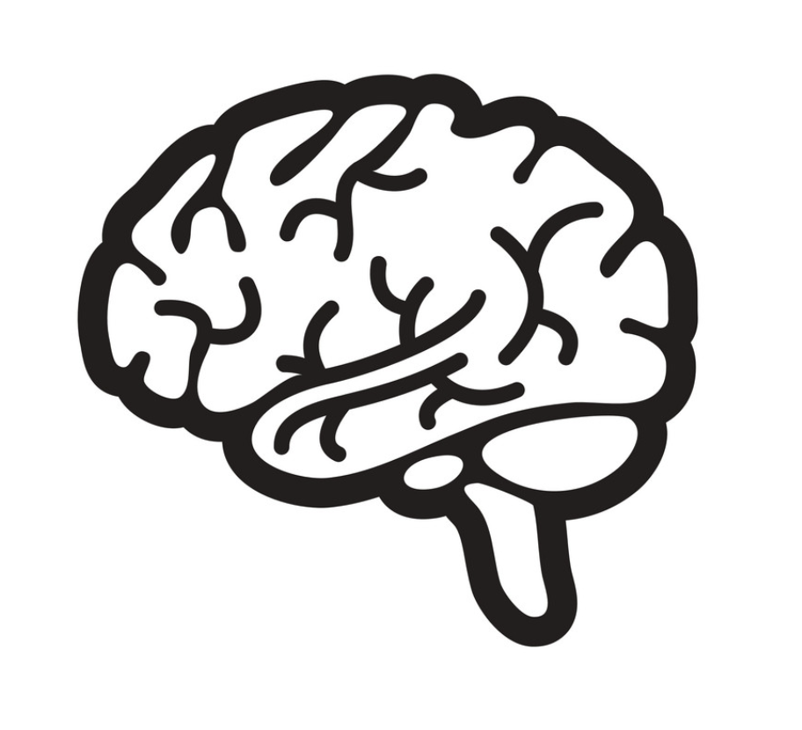
but… how?
👀
Accelerate!
Brake!
Steer!
Notes:
Already have car inputs
What about Brain inputs?

Slide 9
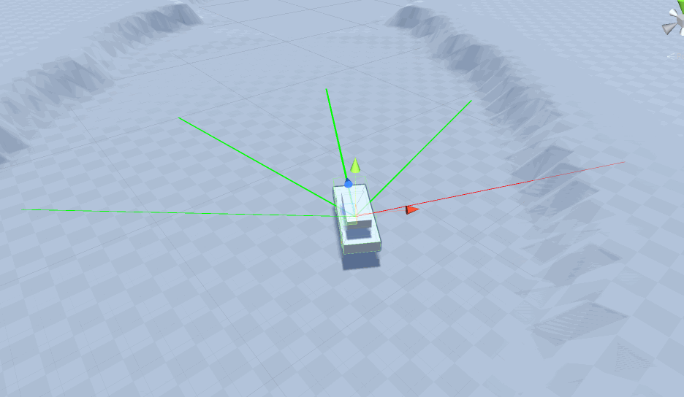
Sensors
Raycasts
Velocity vectors
Angular velocity
Notes:
Also knows the velocity and angular velocity
Makes calculations on each frame

Slide 10
DEMO

Slide 11
Genetic Algorithms (again)
Spawn a number of agents
Measure each agent’s “fitness”
Breed the fittest agents
Mutate some of the offspring
Repeat

Slide 12
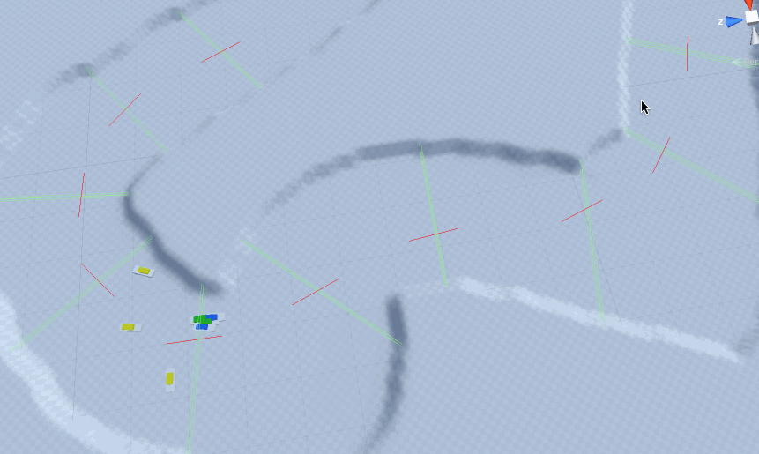
Fitness
Rewards
Number of gates crossed
Position when crossing
Direction when crossing
… but no penalties? (yet)
Crossing more gates vs crossing them ‘correctly’
Becomes more brute force
Notes:
Fitness – crux of genetic algorithm
Starting

Slide 13
Genetic Algorithms (again)
Spawn a number of agents
Measure each agent’s “fitness”
Breed the fittest agents
Mutate some of the offspring
Repeat

Slide 14
Creating The Next Generation
Previous generation
(ranked by fitness)
Unchanged
Offspring
Mutants
New genes
Notes:
Variables – proportions, mutation severity

Slide 15
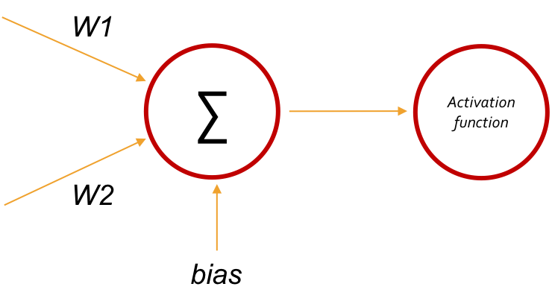
DNA & Chromosomal Crossover
X1
X2
0.45, 0.92, -0.34, 0.63, -0.02, …, 0.53
-0.38, -0.32, 0.77, 0.03, -0.49, …, -0.93
-0.45, -0.32, 0.77, 0.63, -0.02, …, -0.93
Notes:
ALSO mutation

Slide 16
Evolving the network structure
Input layer
Hidden layers
Output layer

Slide 17
Input layer
Hidden layer
Output layer
Current velocity vector
Current angular velocity vector
Acceleration decision
Proximity to obstacles on ahead
Steering decision
Proximity to obstacles on left
Braking decision
Proximity to obstacles on right
Direction of data flow

Slide 18
What next?
Half coding project/half science experiment
Evolve more things
Refine fitness calculation
Create training tracks
Try a different training method
Apply it to a different game/context
Notes:
Evolve more things
Activation function
NEAT
The physical car itself
Refine fitness calculation
- Make it less brute force
- Evolving the evolving mechanism itself?
Create training tracks
- Start simple, get more complex, like in real life
Try a different training method
Apply it to a different game/context
- Santa game

